Slide 1
FNR 59800-018 Intro to R Programming
PFEN 202
Mon, Tue, Thu 8:30-12:20; Fri 12:20-2:20

Slide 2
Day 3 plan
Correlations
Linear regressions/ANOVA
Clustering techniques
“For” loops
Apply functions
Work on projects

Slide 3
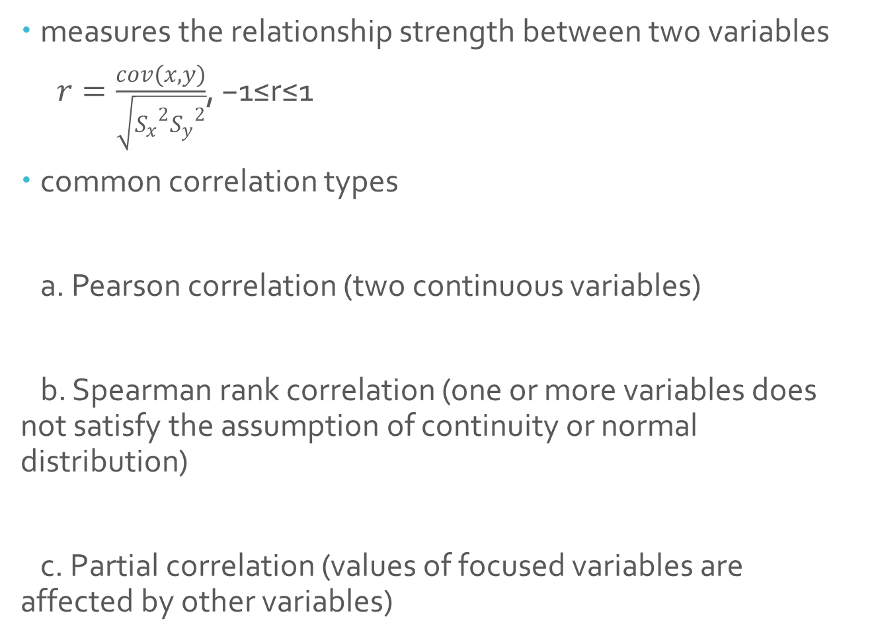
Correlations
measures the relationship strength between two variables
$r=\frac{cov(x,y)}{\sqrt{{S_{x}}^{2}{S_{y}}^{2}}}$, −1≤r≤1
common correlation types
a. Pearson correlation (two continuous variables)
b. Spearman rank correlation (one or more variables does not satisfy the assumption of continuity or normal distribution)
c. Partial correlation (values of focused variables are affected by other variables)

Slide 4
Correlations
Pearson correlation and Spearman rank correlation in R
Usage: cor(x, y = NULL, use = "everything",
method = c("pearson", "kendall", "spearman"))
Default: cor(x,y) ###pearson correlation
cor.test(x, y, alternative = c("two.sided", "less", "greater"),
method = c("pearson", "kendall", "spearman"),
exact = NULL, conf.level = 0.95, continuity = FALSE, …)

Slide 5
Correlations
Example 1. Correlation between temperature and ozone in New York
##### Pearson correlation between two variables
data <- read.csv('ozone.csv', header=T)
x <- data [,5] ## temperature
y <- data [,2] ## ozone level
plot(x,y, xlab=“temperature”, ylab=“ozone”)
### calculate correlation directly with the function cor()
cor(x,y)
### to get the full result including the significance level p with function cor.test()
cor.test(x,y)

Slide 6
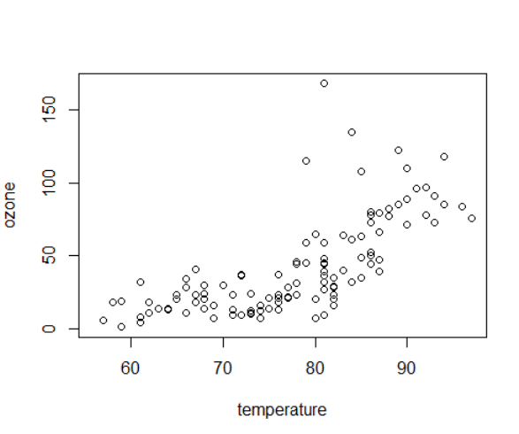
Correlations
Example 1. Correlation between temperature and ozone in New York
Pearson's product-moment correlation
data: x and y
t = 10.192, df = 109, p-value < 2.2e-16
alternative hypothesis: true correlation is not equal to 0
95 percent confidence interval:
0.5888139 0.7829869
sample estimates:
cor
0.6985414

Slide 7
Regressions
Regression analysis is a statistical method for estimating the relationships between dependent (responsive) variable and independent (explanatory) variables. There could be more than one independent variables.
What you need to know before performing a regression analysis: data, variables, models.
Common regression analysis:
bivariate regression
multiple regression
linear regression
polynomial regression
piecewise regression
non-linear regression
…

Slide 8
Regressions
Linear regression and maximum likelihood estimates
y=ax+b (a: slope, b: intercept)
assumption: y residuals, which are the differences between measured and model predicted y values, are normally distributed.
The method of least squares gives the maximum likelihood estimates.
Usage: lm(formula, data, subset, weights, na.action, method = "qr", model = TRUE, x = FALSE, y = FALSE, qr = TRUE, singular.ok = TRUE, contrasts = NULL, offset, ...)
Default form: lm(y~x)
##### linear regression model of ozone level with temperature
data <- read.csv('ozone.csv', header=T)
x <- data [,5] ## temperature
y <- data [,2] ## ozone level
lm(y~x) ## linear model regression
summary(lm(y~x)) ## summarize all results of the linear model regression
plot(x,y, xlab=“temperature”, ylab=“ozone” ) ## plot the data
abline(lm(y~x)) ##include the regression line in the plot

Slide 9
Regressions
> summary(lm(y~x)) ## summarize all results of the linear model regression
Call:
lm(formula = y ~ x)
Residuals:
Min 1Q Median 3Q Max
-40.922 -17.459 -0.874 10.444 118.078
Coefficients:
Estimate Std. Error t value Pr(>|t|)
(Intercept) -147.6461 18.7553 -7.872 2.76e-12 ***
x 2.4391 0.2393 10.192 < 2e-16 ***
---
Signif. codes: 0 ‘***’ 0.001 ‘**’ 0.01 ‘*’ 0.05 ‘.’ 0.1 ‘ ’ 1
Residual standard error: 23.92 on 109 degrees of freedom
Multiple R-squared: 0.488, Adjusted R-squared: 0.4833
F-statistic: 103.9 on 1 and 109 DF, p-value: < 2.2e-16

Slide 10
ANOVA (Analysis of Variance)
Idea: compare two or more means through their variances
Explanatory variables are categorical
Each variable is a factor, which has two or more levels
A single factor ANOVA also called one-way ANOVA
Student t test can be viewed as a special form of ANOVA for a single factor of 2 levels
Usage: aov(formula, data = NULL, projections = FALSE, qr = TRUE, contrasts = NULL, …)
You can also use the R function anova ( )

Slide 11
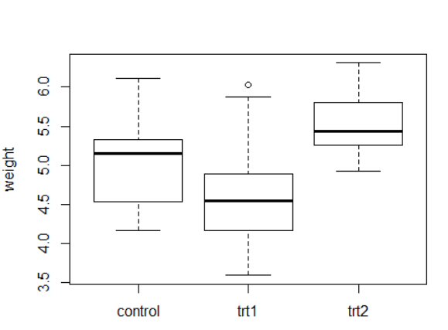
ANOVA (Analysis of Variance)
##### compare the impact of different treatments on plant growth
rm(list=ls(all=TRUE))
data<-read.csv('plant weight.csv', header=T)
y<-data[,3]
trt<-data[,2]
plot(trt,y,names=c("control","trt1","trt2"), ylab="weight")
summary(aov(y~trt))
> summary(aov(y~trt))
Df Sum Sq Mean Sq F value Pr(>F)
trt 2 3.766 1.8832 4.846 0.0159 *
Residuals 27 10.492 0.3886
---
Signif. codes: 0 ‘***’ 0.001 ‘**’ 0.01 ‘*’ 0.05 ‘.’ 0.1 ‘ ’ 1

Slide 12
Cluster analysis
one type of multivariate statistics without a responsive variable
instead, we look for structure in data
cluster analysis look for groups in data
three ways to allocate individuals to groups - partitioning, hierarchical, and discriminant analysis

Slide 13
Cluster analysis
Hierarchical cluster analysis
to show which of a set of samples are most similar to one another, and to group those similar samples in the same limb of a tree.
Usage: d <- dist(data, method=”euclidean”) # find distance matrix hc <- hclust(d, method=”complete”) # apply hirarchical clustering plot(hc) # plot the dendrogram

Slide 14
Cluster analysis
Example: use body weight and brain size to cluster animals
rm(list=ls(all=TRUE))
data<-read.csv('weight.csv', header=T, row.name=1)
d<-dist(data,method="euclidean")
hc<-hclust(d,method="complete")
plot(hc)

Slide 15
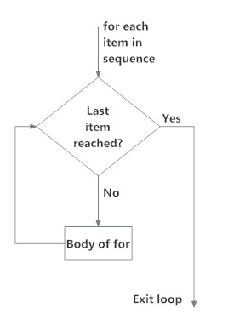
“For” loops
Description: Performs the same task a specific number of times using elements in a sequence.
Structure of “for” loops
for (element in sequence) {
task
}

Slide 16
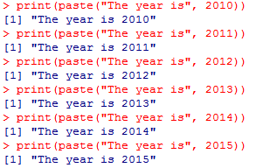
“For” loops
print(paste("The year is", 2010))
print(paste("The year is", 2011))
print(paste("The year is", 2012))
print(paste("The year is", 2013))
print(paste("The year is", 2014))
print(paste("The year is", 2015))

Slide 17
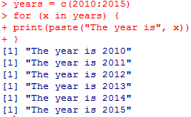
“For” loops
years = c(2010:2015)
for (x in years) {
print(paste("The year is", x))
}

Slide 18
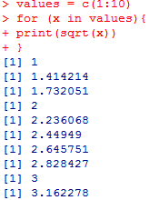
“For” loops
values = c(1:10)
for (x in values){
print(sqrt(x))
}

Slide 19
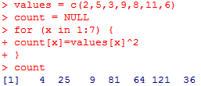
“For” loops
values = c(2,5,3,9,8,11,6)
count = NULL
for (x in 1:7) {
count[x]=values[x]^2
}
count

Slide 20
Apply functions
apply
by
eapply
lapply
mapply
tapply
Apply Functions Over Array Margins
Apply a Function to a Data Frame Split by Factors
Apply a Function Over Values in an Environment
Apply a Function over a List or Vector
Apply a Function to Multiple List or Vector Arguments
Apply a Function Over a Ragged Array

Slide 21
apply()
Description: Returns a vector or array or list of values obtained by applying a function to margins of an array or matrix.
apply(matrix, margin, function)
1 (row) or 2 (column)
Name of matrix
Function

Slide 22
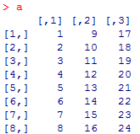
apply()
Example
Create matrix
a = matrix(c(1:24), nrow = 5 , ncol = 3)

Slide 23

apply()
Calculate means for rows
apply(a, 1, mean)
Calculate means for columns
apply(a, 2, mean)

Slide 24
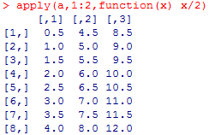
apply()
Divide all numbers by 2
apply(a, 1:2, function(x) x/2)

Slide 25
lapply()
Description: Returns a list of the same length as list X, each element of which is the result of applying a function to a list X.
lapply(list, function)
Function
Name of list

Slide 26
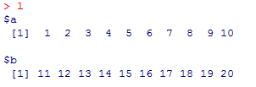
lapply()
Example
Create list
l = list(a= 1:10, b = 11:20)

Slide 27


lapply()
Calculate means of elements a and b of list l
lapply(l, mean)
Calculate sum of elements a and b of list l
lapply(l, sum)

Slide 28
tapply()
Description: Apply a function to a set of values grouped by a selected factor in a data frame.
A dataset that can be broken up into groups
You want to break it up into groups
Within each group, you want to apply a function
tapply(summary variable, grouping variable, function)
Variable used to group dataset
Variable onto which apply function
Function

Slide 29
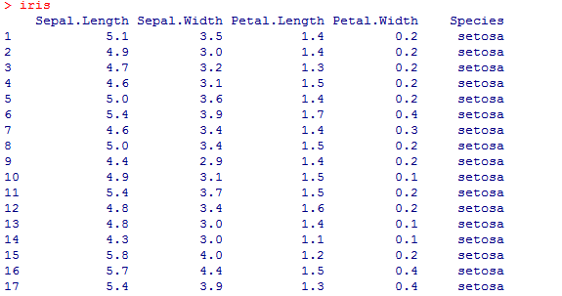
tapply()
Example
Download dataset
data(iris)
attach(iris)

Slide 30


tapply()
Obtain mean petal length for each species
tapply(Petal.Length, Species, mean)
Obtain maximum petal length for each species
tapply(Petal.Length, Species, max)

